Slide 1

Learning Probabilistic Models for Cardiovascular Data
Kate Sanders, Robert Long, Nandini Ramanan, and Dr. Sriraam Natarajan
This material is based upon work supported by the National Science Foundation under Grant No.CNS-1560276. Any opinions, findings, and conclusions or recommendations expressed in this material are those of the author(s) and do not necessarily reflect the views of the National Science Foundation
Notes:
Kate:
Good afternoon. My name is Kate Sanders. Today Rob and I will be presenting the results of our summer research project: Bayesian Modeling of CARDIA Data. This project could not have been completed without the guidance of Dr. Natarajan and Nandini or the financial support of the National Science Foundation.

Slide 2
Coronary Heart Disease
16.5 million - Americans over the age of 20 with CHD
1 in 7 - deaths caused by CHD
790,000 – heart attacks in America every year
Notes:
Rob:
16.5 million Americans currently suffering from Coronary Heart Disease, or CHD. It is the leading cause of death in the United States. In fact, 1 in 7 deaths are directly caused by CHD. The most sudden and deadly cardiovascular event linked to CHD is a Myocardial Infarction, commonly known as a heart attack. Each year, approximately 790,000 heart attacks occur in the US. This means that, on average, a heart attack occurs in America every 40 seconds.

Slide 3

CARDIA
5115 subjects with even distributions for:
Sex
Race
Age
Education Level
1985-6 until present
Years 0, 5, 7, 10, 15, & 20
Retention Rate of 72%
4 data collection sites
Clinical and Non-Clinical data
Notes:
Kate:
Because of this, many recourses have been put towards studying the causes of CHD. One prominent longitudinal study is called CARDIA. This study started in 1985 with 5115 subjects. Each of the 4 collection sites recruited an approximately even number of men and women; black and white people; people who were between 18 and 24 or 25 and 30; and those who had and had not completed high school. The retention rate was high, with a majority of participants returning each year. In our study, we used data from years 0, 5, 7, 10, 15, and 20 with a strong focus on the last year.
At each check-in, both clinical and non-clinical data was recorded. Clinical data gauges heath through measurements such as glucose levels, whereas non-clinical questions focus things such as education level and smoking status.
Many of the data measurements, such as cholesterol, were continuous. We discretized continuous data from each year by quintiles, 5 even groups based on frequency. We replaced missing values using the mean of that person‘s feature data in all observed years. The only reasons we excluded a person from our analysis were if a feature hadn’t been observed for any year or if CAC levels were not observed in year 20.

Slide 4
Methodology
Learning Bayesian Networks over 17 factors
Structure learning algorithms
Hill Climbing
AIC
BIC
BDe
Focused on year 20 data
Notes:
Rob:
Lots of resources have gone into researching the causes of CHD. Looking at one risk factor at a time doesn’t capture the full picture of CHD development since there are many complex, temporal interactions at play. In order to capture these complex interactions, we created Bayesian Networks using CARDIA data. We particularly wanted to examine the interaction of risk factors within each time slice, with a focus on year 20 since that is when the most people have observably high CAC levels. CAC, or Coronary Artery Calcification, is a reliable indication that an individual has CHD.

Slide 5
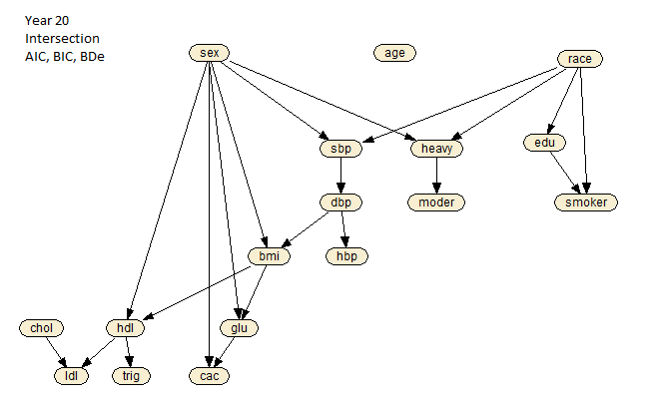
Notes:
Kate:
We used the R package bnlearn to learn the network for each year using three scoring metrics: AIC, BIC, and BDe. The network you can see now is the intersection between the scoring metrics for year 20. One of the most immediately noticeable thing is the lack of edges coming from age. This is because everyone in this time slice is roughly the same age, which makes it a negligible factor.
Rob:
These green boxes indicate expected influences. It shouldn’t be a surprise that those who can complete heavy exercise can also complete moderate exercise or that different blood pressure and cholesterol measurements are related.
Rob:
The red groupings show more interesting relationships. From this we can see that sex and glucose levels influence the probability of an individual’s CAC levels. We also noticed some other relationships that we would like to explore further, such as the how race and education effect smoker status.

Slide 6
Findings
Sex and glucose influence CAC
Sex and BMI influence glucose levels
Race influences education
Education and race influence smoking
Notes:
Kate:
Since Glucose levels play a large role in CAC presence for year 20, we also wanted to analyze the CPT for glucose. As you can see from the diagonal in both sexes, those with a low BMI are most likely to have a low glucose level and those with a high BMI are most likely to have a high glucose level. Again, sex plays an important role. Men are generally more likely to have a high glucose level for any BMI. This partially explains the sex difference in CAC levels. At any BMI, men have higher glucose levels, which directly influences CAC levels.

Slide 7
Conclusion
Year 20 Bayesian Network fit known correlations.
Interesting correlations were also observed
Future Work
Create network with all years’ data
Track the progress of each factor
Notes:
Kate:
*Conclusion*

Slide 8
CAC CPT
 | Glu | [ 0, 82 ] | ( 82, 88 ] | ( 88, 93 ] | ( 93, 100 ] | ( 100, 448 ] | Cac | Sex
 |  | 0.931 | 0.895 | 0.862 | 0.811 | 0.711 | 0 | 0
 |  | 0.068 | 0.104 | 0.137 | 0.188 | 0.288 | 1 | 0
 |  | 0.958 | 0.949 | 0.921 | 0.915 | 0.876 | 0 | 1
 |  | 0.041 | 0.05 | 0.078 | 0.084 | 0.123 | 1 | 1

Slide 9
Edu CPT
Race | 0 | 1 | Edu
 | 0.389 | 0.184 | [ 0, 12 ]
 | 0.292 | 0.184 | ( 12, 14 ]
 | 0.091 | 0.047 | (14, 15.3 ]
 | 0.142 | 0.274 | (15.3, 16]
 | 0.084 | 0.31 | ( 16, 40.3 ]

Slide 10
Glucose CPT
BMI | [ 0, 22. 8 ] | ( 22. 8, 25.6 ] | ( 25.6, 28.6 ] | ( 28.6, 33.2 ] | ( 33.2, 154 ] | Glu | Sex
 | 0.337 | 0.172 | 0.12 | 0.049 | 0.052 | [ 0, 82 ] | 0
 | 0.294 | 0.249 | 0.175 | 0.147 | 0.113 | ( 82, 88 ] | 0
 | 0.174 | 0.207 | 0.218 | 0.184 | 0.083 | ( 88, 93 ] | 0
 | 0.14 | 0.228 | 0.244 | 0.27 | 0.236 | ( 93, 100 ] | 0
 | 0.053 | 0.141 | 0.241 | 0.349 | 0.513 | ( 100, 448 ] | 0
 | 0.406 | 0.327 | 0.236 | 0.176 | 0.131 | [ 0, 82 ] | 1
 | 0.267 | 0.281 | 0.261 | 0.242 | 0.156 | ( 82, 88 ] | 1
 | 0.161 | 0.191 | 0.198 | 0.214 | 0.188 | ( 88, 93 ] | 1
 | 0.111 | 0.131 | 0.184 | 0.218 | 0.229 | ( 93, 100 ] | 1
 | 0.052 | 0.068 | 0.119 | 0.15 | 0.294 | ( 100, 448 ] | 1

Slide 11
Smoker CPT
 | Edu | [ 0 , 12 ] | (12, 14 ] | (14, 15.3 ] | (15.3, 16 ] | ( 16, 40.3 ] | Smoker | Race
 |  | 0.412 | 0.558 | 0.555 | 0.758 | 0.748 | 0 | 0
 |  | 0.13 | 0.129 | 0.177 | 0.108 | 0.132 | 1 | 0
 |  | 0.456 | 0.312 | 0.266 | 0.132 | 0.118 | 2 | 0
 |  | 0.31 | 0.435 | 0.46 | 0.643 | 0.706 | 0 | 1
 |  | 0.223 | 0.244 | 0.252 | 0.241 | 0.226 | 1 | 1
 |  | 0.465 | 0.32 | 0.286 | 0.114 | 0.067 | 2 | 1

